Slide 1

OBJECT AND DiSTANCE Detector
Project By-
Team Robolution
(Saurav & Bibha)

Slide 2

CONTENTS
Purpose and Uses.
Working.
Components Used lists.
Codes used.
Biblography
Developed By-
Team Robolution

Slide 3

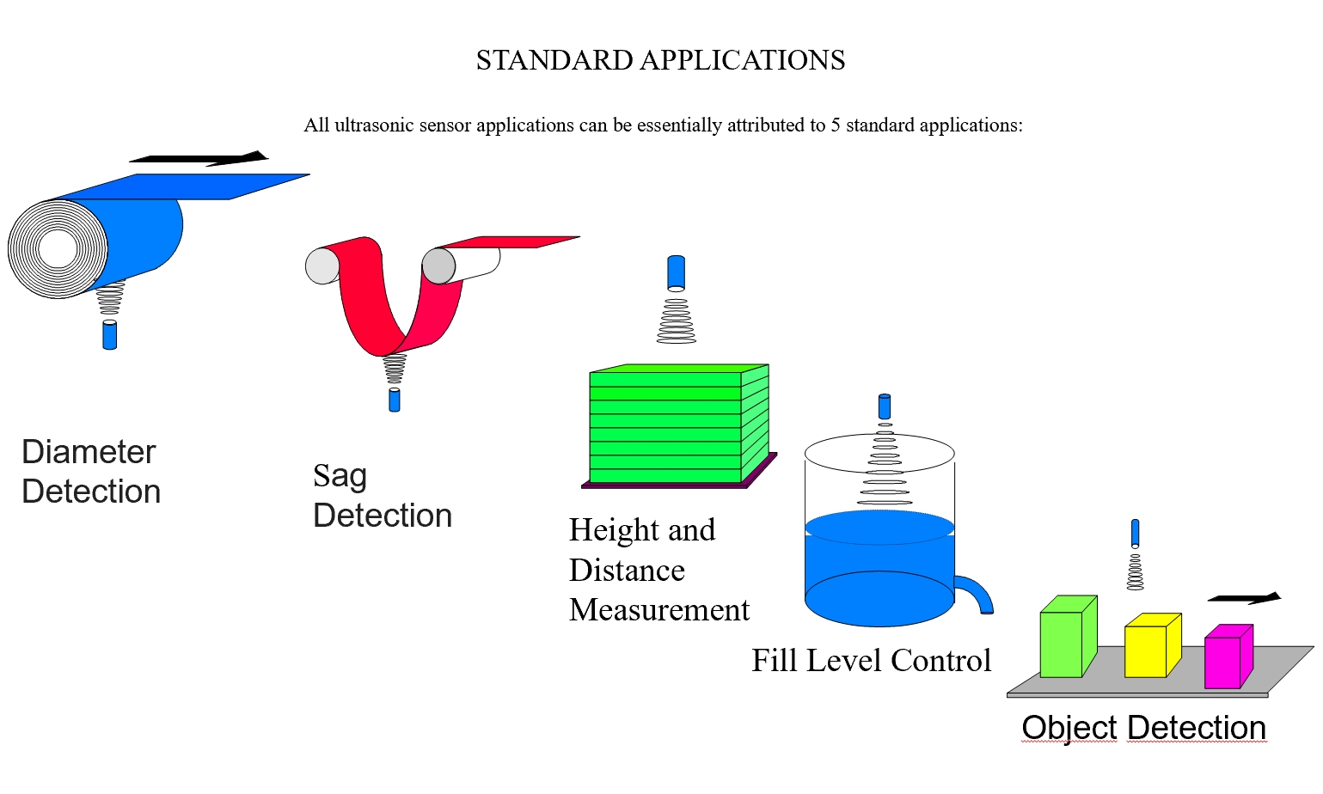
1.PURPOSE AND USES
Used for measuring length,
height, distance, etc.
2. Used as “Thief detector”.

Slide 4
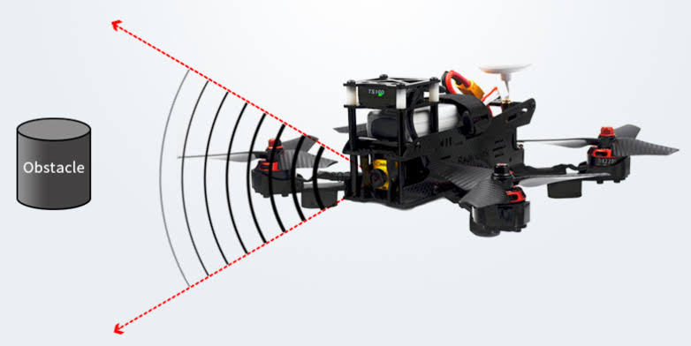
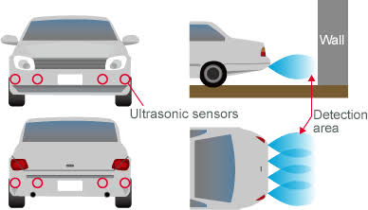
4. Used for “Safley Car Parking” and more.
3. Obstacle detector for Robots.

Slide 5
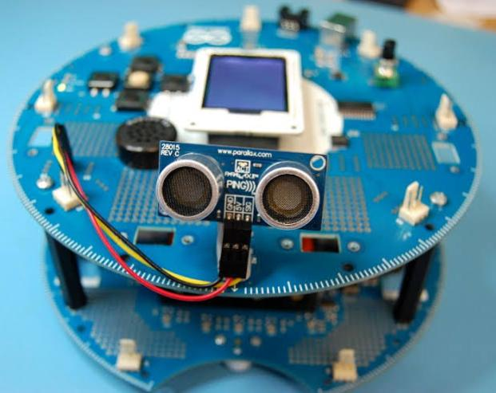
2. WORKING
STEP 3
Echo or reciver of ultrasonic sensor revive the reflected wave and then the lcd shows the distance, buzzer sound , and led glows.
STEP 1
STEP 2
Trigger or Transmitter of ultrasonic sensor create a pluse with the speed of sound wave.
Then the pulse/sound wave stuck on object and get reflected back.

Slide 6

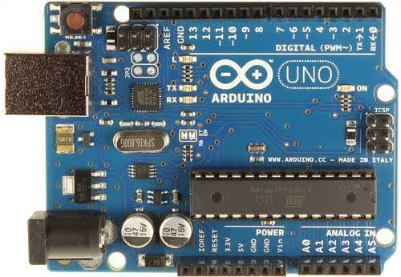
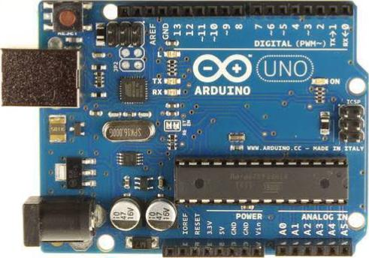
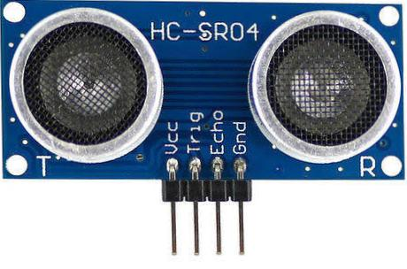
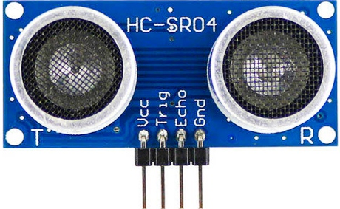
3. COMPONENTS USED
COMPONENTS | USES | QUAN TITY | PRICE
In Rs.
Able to read inputs and also gives outputs as per our commands.
https://www.amazon.in/dp/B06XBMB9T1/ref=cm_sw_r_cp_apa_fabc_N2XBA5KS0MVHM46SV8E0
Arduino Board
X1 pcs.
Rs.518
Ultrasonic Sensor
X1 pcs.
https://www.amazon.in/dp/B08H2C34KL/ref=cm_sw_r_cp_apa_fabc_SWHNG6GW8VX97ZQQRSSY
Measures the distance of a target object.
Rs.89

Slide 7
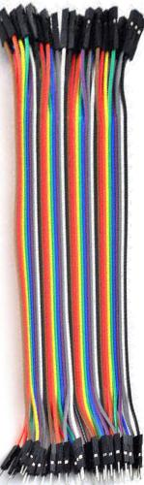
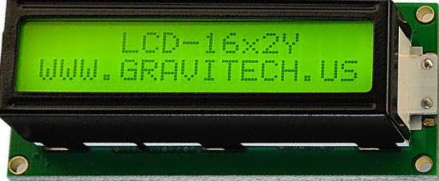
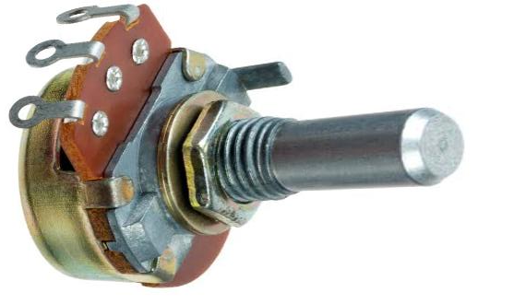
COMPONENTS | USES | QUAN TITY | PRICE
X1 pck.
(40 pcs.)
Normally used to interconnect the components.
https://www.amazon.in/dp/B073Q335BW/ref=cm_sw_r_cp_apa_fabc_W9HYQ6NH43EW62014NQX
Jumper Wire
Rs.155
X1 pcs.
https://www.amazon.in/dp/B00XT53RI0/ref=cm_sw_r_cp_apa_fabc_BPKWHN7XBFSCG9MB6TK2
To project on-screen information.
Rs.204
LCD display
Potentiometer
X1 pcs.
https://www.amazon.in/dp/B07L3YCTGJ/ref=cm_sw_r_cp_apa_fabc_VJQMWC7PYJQSTVMG9JR1
For changing brightness in LCD.
Rs.56

Slide 8
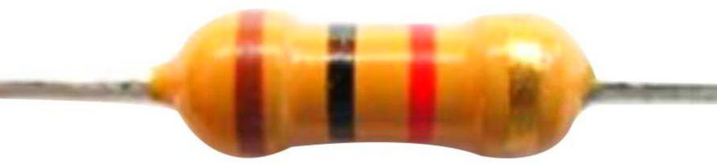
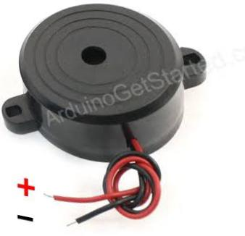
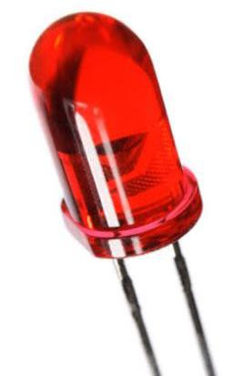
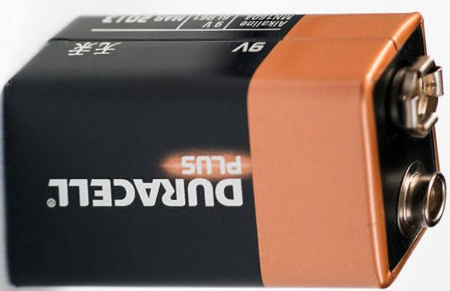
COMPONENTS | USES | QUAN TITY | PRICE
X1 pcs.
https://www.amazon.in/dp/B06ZZ47H11/ref=cm_sw_r_cp_apa_fabc_E5QK5JDZFTW3E8V12JC3
Used to reduce current flow.
Resistor
Rs.33
X1 pcs.
https://www.amazon.in/dp/B01HRCZICS/ref=cm_sw_r_cp_apa_fabc_CZ72PYX10AA2HEBN0YDS
Buzzer
Create Sound.
Rs.40
LED red color
X1 pcs.
https://www.amazon.in/dp/B07L8HZS2Q/ref=cm_sw_r_cp_apa_fabc_5P3J5D0CSAR1XZWKFH4M
For signal light.
Rs.50
For power Supply in ardiuno.
X1 pcs.
https://www.amazon.in/dp/B014SZPFKW/ref=cm_sw_r_cp_apa_fabc_dlT1_373P1ZDE2A80WZPBE40H
9V battery
Rs.259

Slide 9
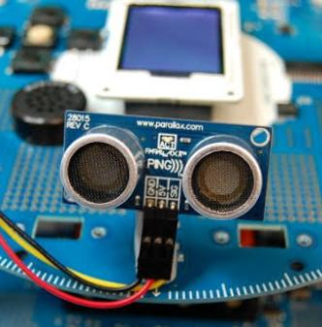
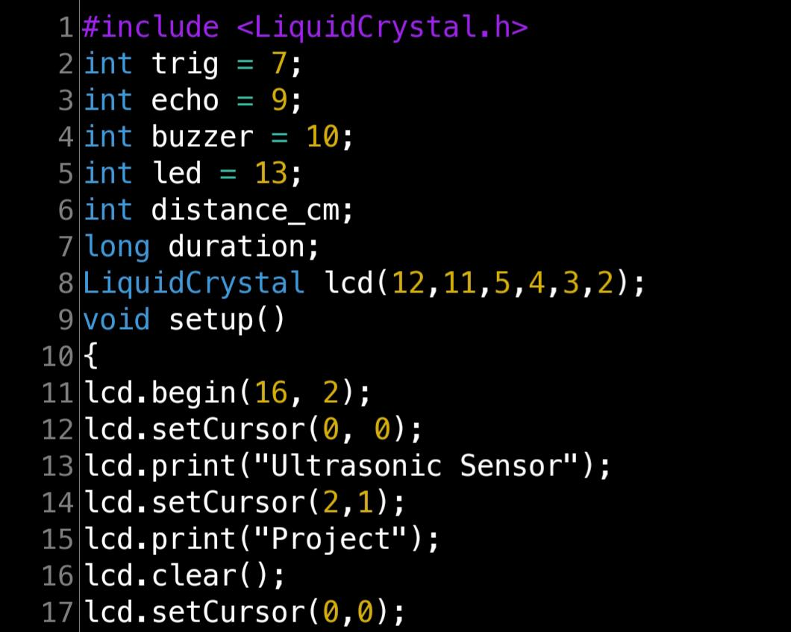
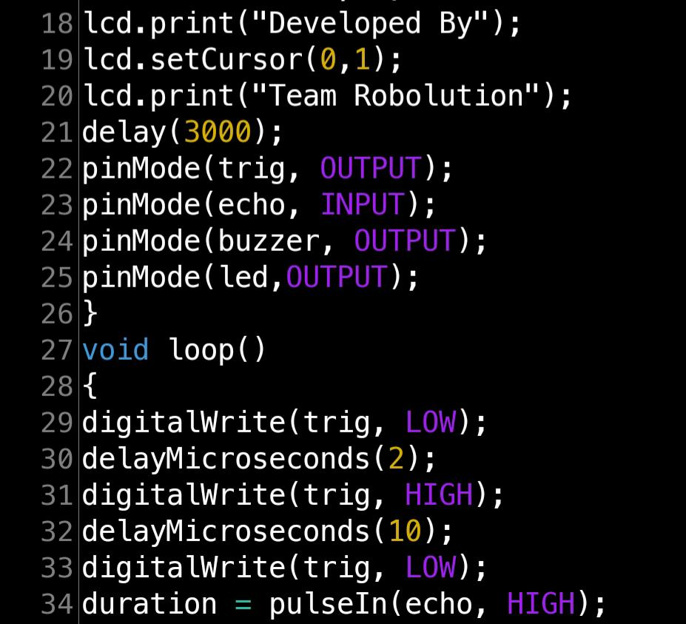
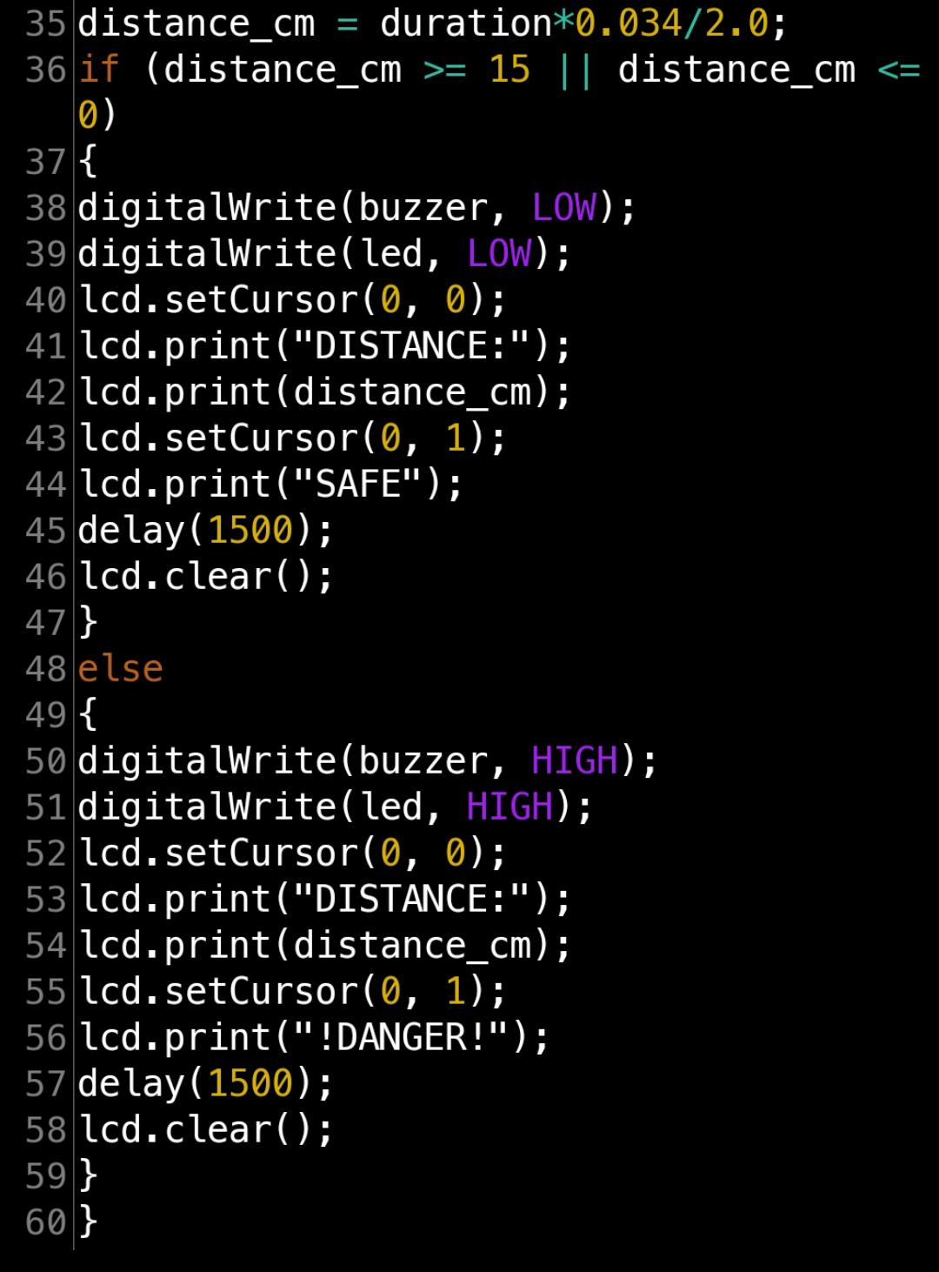
4. CODES USED
Developed By-
Team Robolution

Slide 10
5. BIBLOGRAPHY
Project Source
Image Source
Codes Source
1.Lesson 20: Ardiuno project of LCD, toptechboy.com, Paul Mc Shorter.
1. Google.
1. toptechboy.com
2. create.ardiuno.cc .
3. Youtube and google.
2. Wikipedia.
3. Printest.
2. Wikipedia.
4. Blogs.
3. Ggolge And Youtube.
Developed By-
Team Robolution

Slide 11

Developed By-
Team Robolution

